Slide 1
ADO.NET - Lesson 07
Using Stored Procedures
Training time: 15 minutes
Author: CuongNV3

Slide 2
Objectives
Learn how to modify the SqlCommand object to use a stored procedure.
Understand how to use parameters with stored procedures.

Slide 3
Introduction
A stored procedures is a pre-defined, reusable routine that is stored in a database. SQL Server compiles stored procedures, which makes them more efficient to use.
Therefore, rather than dynamically building queries in your code, you can take advantage of the reuse and performance benefits of stored procedures.
The following sections will show you how to modify the SqlCommand object to use stored procedures. Additionally, you'll see another reason why parameter support is an important part of the ADO.NET libraries.

Slide 4
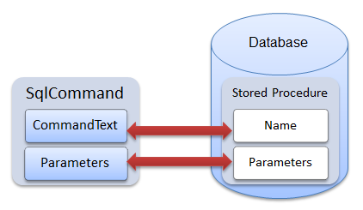
Introduction (2)

Slide 5
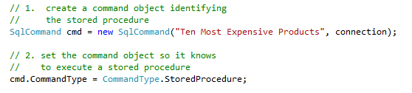
Executing a Stored Procedure
In addition to commands built with strings, the SqlCommand type can be used to execute stored procedures.
There are two tasks require to make this happen:
  Let the SqlCommand object know which stored procedure to execute
  Tell the SqlCommand object that it is executing a stored procedure.

Slide 6
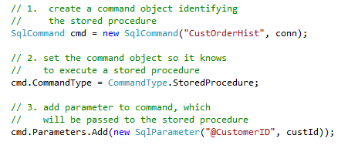
Sending Parameters to Stored Procedures
Using parameters for stored procedures is the same as using parameters for query string commands.
The following code shows this:
Demo

Slide 7
Summary
To execute stored procedures, you specify the name of the stored procedure in the first parameter of a SqlCommand constructor and then set the CommandType of the SqlCommand to StoredProcedure.
You can also send parameters to a stored procedure by using SqlParameter objects, the same way it is done with SqlCommand objects that execute query strings.
Once the SqlCommand object is constructed, you can use it just like any other SqlCommand object as described in previous lessons..

Slide 8
Q&A
Thanks!

